Slide 1
Audio Visual Production
Lecturer: Mr. Bakary Njie

Slide 2
Course Overview
Concept of Sound
Audio Equipment
Sound Recording
Audio Editing

Slide 3
Sound
Sound plays a greater role in the field of communication, entertainment, understanding, sharing of the information. It is one of the most important fields for electronic media like Television, Radio, Cinema and Public Broadcasting. The world of modern music is becoming so popular that the audio technology has become simpler.

Slide 4
Audio Equipment
Audio equipment are used for different purpose and for various applications. Audio engineer uses outdoor portable recorder for an outdoor recording and other equipment for studio recording.

Slide 5
Sound Recording
Sound recording is a process that involves both the skill of art and science. The purpose of recording is to restore the information for future use and it may be stored for years. Sound recording process takes multiple steps.

Slide 6
Sound Editing
Audio Editing is done in many stages of audio production. In the post production many things are to be done on the mixing console desk. Noise is an important factor to be remembered and taken care of during track laying and editing. Noise is removed in this stage of audio production.

Slide 7
Learning outcomes
Describe the Concept of Sound and its phenomena.
Name the audio equipment that are used in audio productions.
Differentiate between the types of Microphones.
Explain the Process of Sound Recording
Describe Voice Dubbing process.

Slide 8
Concept of Sound
Introduction
Sound is an important concept in our life. It plays a greater role in the field of communication, entertainment, understanding, sharing of the information. It is one of the most important fields for electronic media like Television, Radio, Cinema and Public Broadcasting. The world of modern music is becoming so popular that the audio technology has become simpler. The sound production abides with different aspects, this is a field where both art and science work together and creates the wonders in the form of music that has a healing power. Imagination, artistic support and technical expertise can give birth to a creative production. Sound recording technology changes with the time.

Slide 9
Role of sound in digital world
social media like facebook, twitter, whatsapp and dealing with voice calling, voice sms, video calling, chatting etc.
Knowingly or unknowingly you are using a camera, video recorder, audio recorder, transmitter and a receiver in the form of a smart phone.
If you want to pursue a career in the media industry, then you have to learn the expertise of media technology. It may be an audio recording, a video shooting or a digital promotion.
Sound technology is one of the widely used in the electronic media and film production.

Slide 10
Sound Terminologies
Wave: A graphic representation that describe sound
Loudness: It is the gain of sound pressure level
Propagation: Travel of sound in air medium
Decibel: Unit of loudness
Amplitude: Distance above or below the centre line of wave
Stimulus: The vibration sensation

Slide 11
What is sound
In our surrounding, many physical events occur. You can see them through the eyes and hear the sound by ears. Sound is a phenomenon that describes the brain’s perception and interpretation of a physical stimulus that arrives to the ears. It is a both physical and psychological phenomenon. Sound is generated from a source attached to the atmosphere which travels through wave propagation in the air. Not only in the air, it can also travel through the water and metal also. It takes place through periodic vibration in the air molecules and reaches to our ear. When it passes into our ear through the external object many things tend to happen and our brains responds to it accordingly.

Slide 12
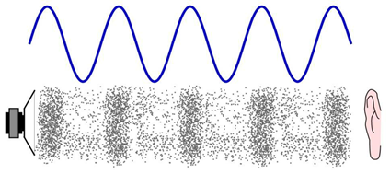
Now let us learn how the ear acts. The Sound arrives at our ear in the form of a periodic vibration in the atmospheric pressure known as sound pressure level (SPL). Sound Pressure Level is the acoustic pressure that is built up within a specific atmospheric area. The greater the sound pressure level, the louder the sound. Sound pressure level can be measured in decibel (dB).Our ear can receive the sound vibrations from 360 Degree angle.
Wave Propagation

Slide 13
The vibrating waves travel through the air, medium are collected at the outer ear and then passes through the aural canal of inner ear and hits the stretched drum like membrane called eardrum which is attached to the ear drum, a snail like organ called cochlea that contains so many tinny hairs. The sound waves after reaching the inner ear are then changed into mechanical vibrations, which are transferred to the inner ear of three bones; these three bones are the hammer, anvil and stirrup. These bones act like an amplifier and a limiter, means they help the weak signals to boost and limit the louder sound too (we will discuss on amplifier and limiter in the next unit). The vibrations are then applied to the cochlea-a tubular, snail like organ that contains two fluid filled chambers. Within these chambers there are tiny hair receptors .These tiny hairs can response to different frequencies and are lined in a row along the length of the cochlea. Then the mechanical signals are sent to the brain and this neural stimulation gives us the sense of hearing.

Slide 14
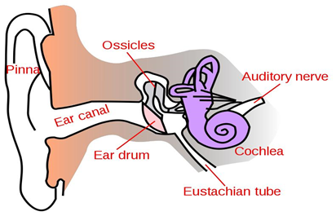
Diagram showing the outer, middle and inner ear

Slide 15
A convenient pressure level that produces the phenomenon of hearing is called threshold of hearing. The minimum Sound Pressure Level (SPL) that is required for hearing in most of the people is equal to 0.0002 microbar. One microbar is equal to one million atmospheric pressure. The SPL that causes discomfort in a listener 50 percent of the time is called the threshold of feeling. It occurs at a level of about 228decibel.The SPL that causes pain in the listener 50 percent of the time is called threshold of pain and it occurs at a level of 140dB.

Slide 16
Types of Sound
We are dealing with so many types of sounds. Some are artificial and some are natural. The sound we hear may be a combination of multiple frequencies, and having different magnitude. The wave forms are in the shape of a triangle wave, sine wave, square wave and saw-tooth wave. Our ear can receive frequency of a single cycle per unit time and a maximum of 20,000 cycles per second.

Slide 17
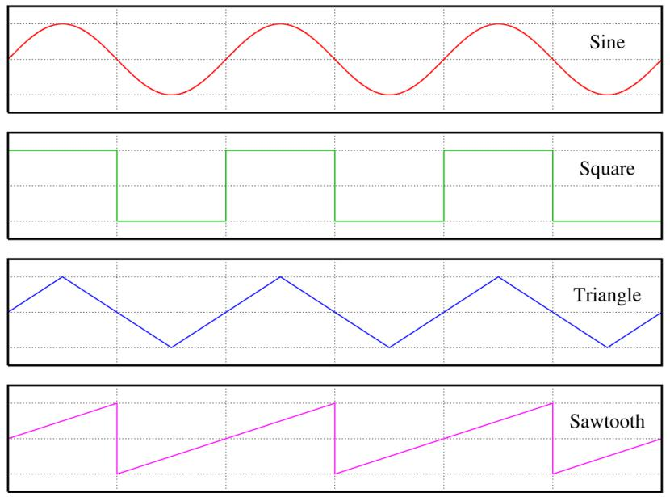
Different wave forms

Slide 18
Frequencies are categorized into low, low-mid, high-mid and high band. There are two kinds of waves they are transverse and longitudinal. Longitudinal waves move parallel to the direction the wave is travelling. Whereas the transverse waves on the other hand is where the vibration is at 90 degrees to the motion of the wave.
When we speak, the sound usually generated at the vocal cord of the throat. Human beings have a definite frequency band in our vocals. Similarly, there are different tones and timber in animals and musical instruments.

Slide 19
Characteristics of a Wave Form
A wave form is the graphical symbol that represent of a signal’s sound pressure level as it moves through a medium over time. A wave form is helpful to see & understand the actual phenomenon that takes place in the physical environment.
Followings are the characteristics of wave form.
They include: Amplitude, Frequency, Wave length, Velocity, Phase, Harmonic content, Envelope.

Slide 20
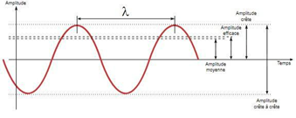
Amplitude: Amplitude is the distance above (+ve) or below (-ve) the centre-line of a wave form. The greater the distance from the centre line, the more louder the sound will be.
Wave form

Slide 21
Frequency: Frequency is termed as the wave vibration per unit time. The number of waves that passes through fixed place in a given time. In other words, it is the number of cycle per second and is measured in Hertz (Hz). The vibrating mass repeats a cycle of positive and negative amplitude. One completed journey on both positive and negative side of the centre line is known as a cycle.

Slide 22
Wave Length: It is the actual distance in a medium
between the beginning and the end of a cycle, and is measured in
Lambda (λ). The wave length changes according to the frequency.
The lower frequencies have a greater wave length and the higher
frequencies have the shorter wave length. Low Frequencies travel
more distance than high frequencies.
The physical length of a wave can be calculated using the formula.
l=v/f
Where l is the wave length in the medium?
V is the velocity in the medium
F is the frequency in hertz

Slide 23
Velocity
In physics the term ‘velocity’ is a rate of change of speed. Like the light, the sound which travels in the air. The speed of sound when it travels through air medium at 68⁰ F or 20⁰ C temperature is approximately 344 meter per second. The speed may vary according to the variations in atmospheric temperature.

Slide 24
Phase:
A cycle can begin at any point on a wave form. It is the position of a point in time on a wave form. When two sine waves combine together, it produces a single sound; their relative amplitude is different at any point of any time.
Phase is measured in degree. The sine wave is usually consider to begin at 0⁰ with zero amplitude and it can increase to a maximum of 90⁰ and then decrease to having a zero amplitude at 180⁰ and then increase to a maximum of 270⁰ (in the negative direction) & finally come back to its original level at 360⁰.
In-Phase: When two waves form and having the same frequency shape & peak amplitude are added, the resulting wave form will have the same frequency, phase &shape but double in amplitude. This wave forms will be called as in-phase wave.
Out-of-Phase: When two waves of different frequency, shape and phase are combined together, it results in a straight line of zero amplitude. That means both the positive phase and negative phase will cancel each other.

Slide 25
Harmonic Contents: A Sine wave is a single frequency that produces a pure tone. Compound sound waves have a combination of multiple frequencies. A piano can produce the tones of different frequencies and at different pitch too. The factors that help us to differentiate between instruments are called partials that exist in addition to the pitch that’s being played which is called fundamental. Partial that are higher than the fundamental frequency are called upper partial or over tone. The over tone frequencies that are whole numbers of multiple of the fundamental frequency are called harmonies.

Slide 26
Acoustic envelope: Every instrument has its unique timber. Timber differentiates one instrument to others. Envelope of a wave form is the characteristic variations in level that occurs over the duration of a played note.

Slide 27
Frequency Response
Frequency response is simply defined as the response to frequency range. Our ears can response to a too low frequency and a too high frequency. This frequency range is known as dynamic range of hearing. And the dynamic range of human ear is 20Hz to 20 kHz.
For example, we can hear the sound of a bass guitar, which carries low and low mid frequencies. And we can also hear the sound of a mosquito which creates extreme high frequencies.

Slide 28
Pitch
Pitch is word that defines the position of a note in the musical scale. Then what is a musical scale? Arrange of notes in different pitch. We can say that the pitch refers to the highness and lowness of a note. Pitch is related to frequency. Two notes are very closely related. In fact it is convenient to give an exact frequency to a particular musical note, or rather the fundamental frequency of that note but we ought to note that the pitch of sound can be affected by its loudness.

Slide 29
Assignments
Discuss the characteristics of wave form.
Write the various medium through which sound can travel.
Describe the construction of ear with diagram.
Name the unit of loudness
Frequency is measured in_______.
List the main obstacles for hearing?
We measure the wave length in______.
What is the dynamic range of human ear?

